Slide 1
2016 CENTRAL PA ENROLLMENT ASSISTER WEBINAR
OPEN ENROLLMENT 2017

Slide 2
agenda
2017 Individual Marketplace
  Medical Products
  Tiering and Deductible
  Unique Features
Network Overview
Pharmacy Information
Contacts
Questions

Slide 3
2017 INDIVIDUAL Marketplace MEDICAL PRODUCTS

Slide 4



CBC 2017 Individual MARKETPLACE Products
PPO 1000/0/20
PPO 4500/0/10

Slide 5
GOLD Plan
PPO 1000/0/20
Benefit | 2017 | 2016
Deductible Medical Prescription Drug Pediatric Dental Maximum Out of Pocket Retail Generic Copay Diagnostic Laboratory Tests when performed at Facility/Hospital owned Lab | $1,000/$2,000 $300/$600 $75 $7,150/ $14,300 $20 after deductible $75 after deductible | $1,000/$2,000 $300/$600 $75 $6,850/$13,700 $16 after deductible Deductible applies

Slide 6

SILVER PLAN
PPO 4500/0/10
Benefit | 2017 | 2016
Deductible Medical Prescription Drug Pediatric Dental Maximum Out of Pocket Retail Generic Copay Diagnostic Laboratory Tests when performed at Facility/Hospital owned Lab | $4,500/$9,000 Combined with medical $75 $7,150/$14,300 $5 after deductible $75 after deductible | $4,500/$9,000 Combined with medical $75 $6,850/$13,700 $5 after deductible $75 after deductible

Slide 7
Tiering AND Deductible

Slide 8

Tiering AND Deductible
Tiering
  Our Marketplace plans do not have tiering.
Deductible
  Depends on plan design
  Example: PPO 4500/0/10
    Deductible applies to all in-network services, including prescription drug, before any copayment or coinsurance are applied. Doesn’t apply to professional services with co-pays, network preventive services, emergence services or emergency ambulance.

Slide 9
UNIQUE FEATURES

Slide 10

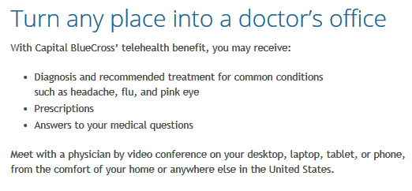
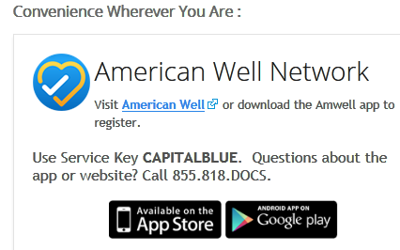
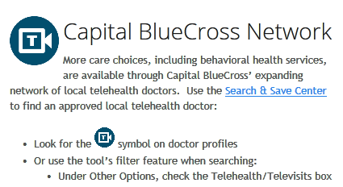
Unique features

Slide 11

Unique Features
The plan becomes even better with
Personal Profile
Complete a health risk assessment
New incentive programs that reward your clients for living healthy!
Earn up to $50 for completion of these activities!
(Eligible to the plan subscriber only)
$25 for online health coaching
$25 for the health risk assessment
Online Health Coaching
Participate in one of the fourteen available online coaching programs
Notes:
New Vendor for Healthy Rewards

Slide 12

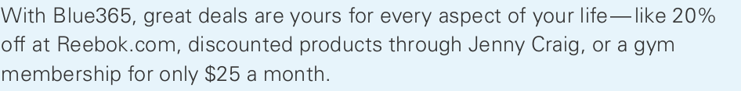

UNIQUE FEATURES
What is Blue365?
Blue365® is a program sponsored by participating local Blue Companies that helps you stay healthier, for less. Since 2007, Blue365 has offered discounts for members to save on products and services for a well balanced lifestyle. These “Blue365 Deals” (which are different than the healthcare benefits that you have with your local Blue Company) can help you maintain a healthy lifestyle, while spending less at some of your favorite Blue365 Vendors nationwide.

Slide 13

UNIQUE FEATURES

Slide 14
NETWORK overview

Slide 15
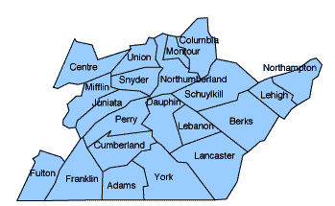
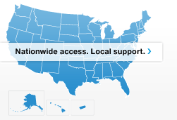
2017 PPO Network
  PPO Network (local and nationwide access)
  Visit capbluecross.com to locate a network provider
100% acute care hospitals
96% acute care hospitals

Slide 16
Pharmacy Information

Slide 17

Pharmacy Information
New
January 2017 - Rite-Aid Pharmacies will be participating in the Advanced Choice Network.

Slide 18
2017 Rx Products
Benefit guidelines
Selectively Closed Formulary
Coverage of brand non-preferred drugs (BNP) is limited to select brand non-preferred drugs
  Multi-source brand drugs excluded
  Most BNP are excluded from coverage
  Non-formulary consideration process to request coverage of BNP based on medical necessity
Information regarding the selectively closed formulary can be found: www.capbluecross.com/wps/wcm/connect/CBC-Public/CBC/Members/DrugFormularyInformation_Forms

Slide 19
Mandatory Mail and Maintenance choice
Continuation of these programs from 2016
Maintenance medication can be purchased in 90-day fills through mail order, or by picking up at CVS (includes locations inside Target stores now operating as CVS/pharmacies)
Cost share is the same as mail order
Limited number of 30-day fills at any pharmacy in the Advanced Choice Network
  Plan will not pay for 30-day fills after this limit has been met

Slide 20
Contact Information

Slide 21
Capital BlueCross Contact information
Customer Service Related Issues:
  1.800.730.7219
Event Reach Out:
  Cecilia Keesecker: 1.717.541.6115
  Cecilia.Keesecker@capbluecross.com

Slide 22
QUESTIONS

